Slide 1
Multi-party Negotiations
Compiled by Dr. Renu Girotra

Slide 2
more than two interested parties work together:
to achieve a collective objective
to discuss the options and make a collective decision
*involves unique dynamics in a collective decision-making process
*different agendas
*varied interests/ involvements

Slide 3
What makes it different from 2-party negotiations
Number of Parties
1.Each party may be acting as a principal—representing its own interests
2. or an agent—representing the interests of at least one other party (the constituency
3. parties may also have different social roles outside the negotiation (e.g., president, vice president, director, board chairman) that may lead to either equal or unequal levels of power and status in the negotiation
Informational and Computational Complexity
Social Complexity (dynamics of groups- motivational cooperation, trust, social pressures)

Slide 4
What makes it different from 2-party negotiations -contd-
Procedural Complexity ( (e.g., opening statements, presentation of viewpoints, moving toward agreement)? , negotiations will take longer,- more time to be allowed; the greater the number of parties- the more complex and out of control the process can become—particularly if some parties adopt a strategy of tough positional bargaining and dominate the conversation ; -------as a result of the first two elements, negotiators shall decide how to manage the process to arrive at the type of solution or agreement they want. Finally, the parties must decide how they want to approach multiple issues)
Logistical Complexity (physical and psychological distance)
Strategic Complexity (surveillance and audience dynamics; negotiators who have some way to control the number of parties may begin to act strategically; chances of coalition

Slide 5
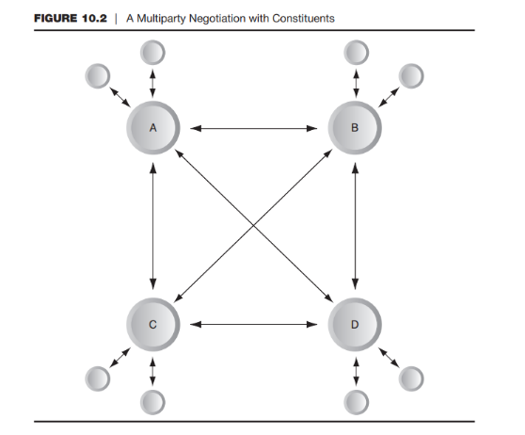

Slide 6
Managing Multiparty Negotiations
Pre-negotiation stage
Formal Negotiation Stage (managing the process and outcome)
Agreement Stage

Slide 7
Managing Multiparty Negotiations
Pre-negotiation stage
Participants (roles, evaluate/ info about participants- supportive/ problem creators)
Coalitions (promoting or blocking the outcome/ agenda)
Defining Group Member roles
Understanding costs and consequences of no agreement (role of BATNA)
Learning the issues and constructing the agenda

Slide 8
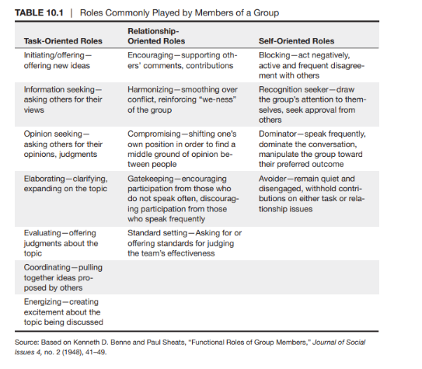

Slide 9
Managing Multiparty Negotiations
Formal Negotiation Stage (managing the process and outcome)
Appoint an appropriate chair (amongst parties or neutral chair)
Use and restructure the agenda
Ensure diversity of information and perspectives (communication of disagreements, freedom to express, divide responsibilities- scouts, coordinators etc; understanding other person/ party's position)
Ensure consideration of all available information (be prepared, side conversations, means for defusing an emotionally charged discussion, tolerate conflicting points of view and perspectives)
Exchange of ideas/ decision making- Delphi technique, Brainstorming, Nominal Group technique)
Manage conflict
Review and Manage the decision rules (consensus rules, discourage- maximising individual gain, entering coalition, goal orientation, decision rules, tactics, decision aids etc.)
Strive for a first agreement (revised, upgraded, improved)
Manage problem team members

Slide 10
Managing Multiparty Negotiations
Agreement Stage
Select the best solution
Develop an action plan
Implement the action plan
Evaluate outcomes and the process

Slide 11
Interteam Negotiation
Features:
Integrative agreements are more likely when teams are involved
teams are sometimes more competitive than individuals and may claim more value
Accountability pressures are different for teams compared to individuals
Relationship among team members affects negotiation process and outcome

Slide 12

COALITIONS
Collection of two or more parties within a larger social setting who work together to pursue mutually desirable goals
Types:
Potential (latent or dormant)
Operating (established or temporary)
Recurring

Slide 13

COALITIONS
Attributes
Coalitions are interacting groups of individuals
Coalitions are deliberately constructed and issue oriented
Exist independent of formal structure
Lacks formal structure
Focus on goals external to the coalition
require concerted member action

Slide 14

How are Coalitions developed
Starts with the founder
Builds by adding one member at a time
Need to achieve critical mass
Excludes some members
Weak ties can be strong
Sometimes coalitions form quietly and disband quickly (Revenge, turmoil within, desire for anonymity)

Slide 15
Power and leverage in coalitions
Identifying the source of strength (Strength in strength, strength in weakness)
Role of power (Strategic, normative, relationship based)
How to build coalitions
Pursue activities have meaning to themselves and to others
Are needed
Generally contribute to the organisation and its purpose
Act with integrity and tell the truth about what they see happening
Strive to be as good and productive

Slide 16
Prospective coalition partners usually along two dimensions
Are the members in high or low agreement with your objectives
Do the members generate from you high or low levels of trust
Categories based on these 2 dimensions
Allies
Opponents
Bedfellows
Fence Sitters
Adversaries

Slide 17
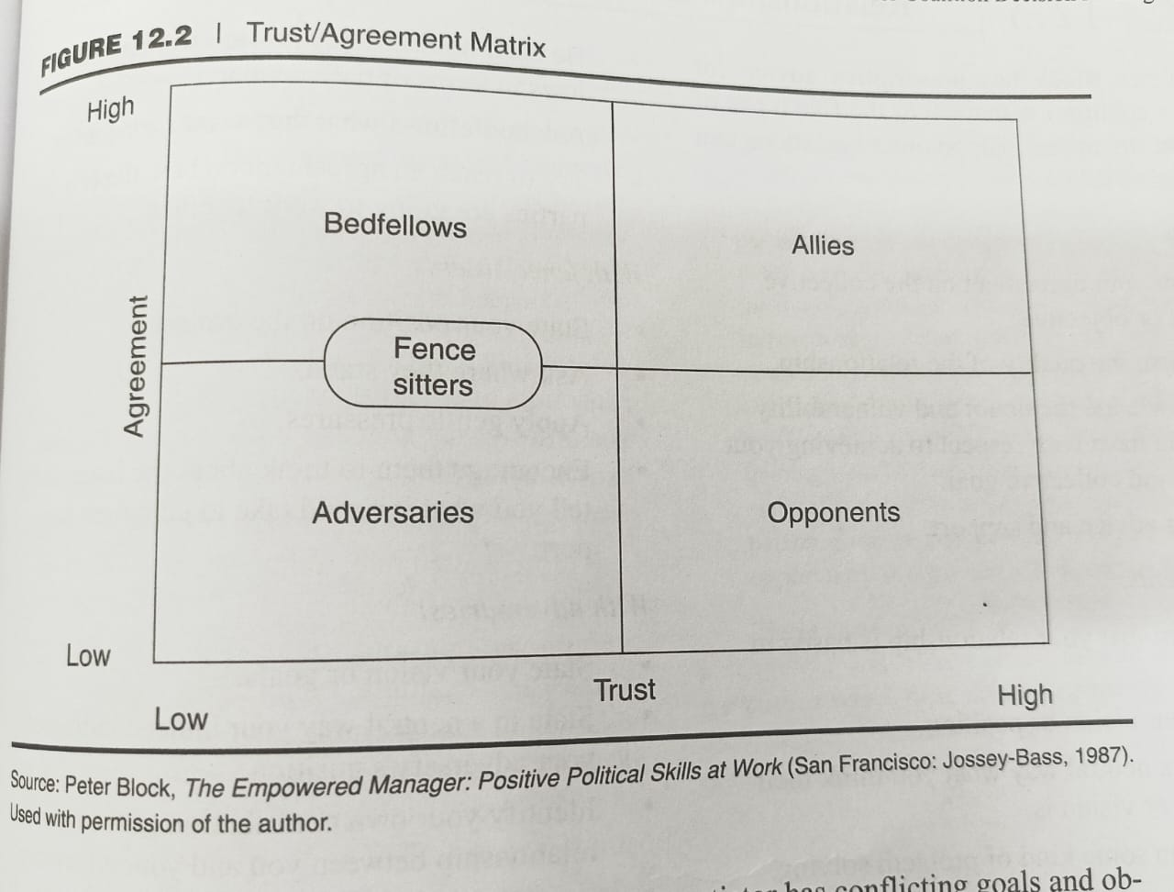

Slide 18
References
Negotiation by Roy J Lewicki, Bruce Barry & David M Saunders , 6th edition
Conflict Management: A practical guide to developing Negotiation Strategies by Budjac Corvette, Barbara A , first edition

Slide 19
THANK YOU

